Slide 1
Publishing Your Android Application

Slide 2
Overview
Discover how to publish your application for discovery by users
Learn how to choose the right distribution model
Learn how to prepare and package your application for publication
Publish your application to Google Play
Learn about Google Play Staged Rollouts and publishing to the Google Play Private Channel
Learn practices for preparing your application for translation
Learn other alternatives for publishing your application

Slide 3
Introduction
After you’ve developed and tested your application, the next logical step is to publish it so that other people can enjoy it
You might even want to make some money
A variety of distribution opportunities are available to Android application developers
Many developers choose to sell their applications through mobile marketplaces such as Google Play
Others develop their own distribution mechanisms—for example, they might sell their applications from a website
Regardless, developers should consider which distribution options they plan to use during the application design and development process, because some distribution choices might require code changes or impose restrictions on content

Slide 4
Choosing the Right Distribution Model
The application distribution methods you choose to employ depend on your goals and target users
Ask yourself the following:
  Is your application ready for prime time?
  Are you trying to reach the broadest audience, or have you developed a vertical market application?
  How will you price your application? Is it freeware or shareware? Are the payment models you require available on the distribution mechanisms you want to leverage?
  Where do you plan to distribute?
  Are you willing to share a portion of your profits?
  Do you require complete control over the distribution process?
  If you plan to distribute yourself, how will you do so? How will you protect user data? What trade laws must you comply with?
  Have you considered creating a free trial version of your application?

Slide 5
Protecting Your Intellectual Property
Now that you’ve built a valuable Android application you want to distribute it, but perhaps you are concerned about reverse engineering of trade secrets and software piracy
As technology rapidly advances, it’s impossible to perfectly protect against either
If you’re accustomed to developing Java applications, you might be familiar with code obfuscation tools, designed to strip easy-to-read information from compiled Java byte codes, making the decompiled application more difficult to understand and reverse engineer
Some tools, such as ProGuard (http://proguard.sourceforge.net), support Android applications because they can run after the .jar file is created and before it’s converted to the final package file used with Android
ProGuard support is built into Android projects created with the Android tools

Slide 6
Protecting Your Intellectual Property (Cont’d)
Google Play also supports a licensing service called the License Verification Library (LVL)
  This is available as a Google Play add-on but works on Android API Level 3 and higher
  It applies only to paid applications distributed through Google Play
  It requires application support—code additions—to be fully utilized, and you should seriously consider obfuscating your code if you use it
  The service’s primary purpose is to verify that a paid application installed on a device was properly purchased by the user
You may also be concerned about rogue applications impersonating your brand or performing trademark and/or copyright infringement
  Google has many mechanisms set up for reporting infringements, so if this does occur, you should follow through with reporting those infringements to protect your brand
  You may also need to consult with legal counsel

Slide 7
Following the Policies of Google Play
When you publish your application to Google Play, you must agree to certain policies that Google enforces
By accepting the Developer Distribution Agreement, you are agreeing to not perform certain prohibited actions that are outlined within the agreement
Another term of service that you agree to is the Developer Program Policies as defined at http://play.google.com/about/developer-content-policy.html
This includes rules that prohibit spam, restrict content, and govern ad implementations, and it even outlines subscription and cancellation policies
Staying up on the current policies of Google Play is very important to avoid any negative repercussions for failure to comply with them

Slide 8
Billing the User
Unlike some other mobile platforms you might have used, the Android SDK does not currently provide built-in billing APIs that work directly from within applications
Instead, billing APIs are normally add-on APIs that are provided by the distribution channels
To sell your applications on Google Play, you must register for a Google Wallet Merchant account
Once registered, you need to connect your Google Wallet Merchant account to your Developer Console account
Google Wallet is the billing provider for processing application payments from within Google Play

Slide 9
Billing the User (Cont’d)
Google Play allows you to sell your application in 130 different countries, enabling you to accept the currencies that your users are used to spending
Users can make purchases from their Android devices or from the Web, and Google Play provides an easy way to track and manage the entire process
Google Play accepts many different forms of payment, including direct carrier billing, credit card, gift card, or a stored Google Play balance
Any revenue that you generate is paid out to you in monthly installments to your Google Wallet Merchant account

Slide 10
Billing the User (Cont’d)
If an application needs to charge ad hoc fees for goods sold within the application (that is, subscriptions or in-app products), the application developer must implement an in-app billing mechanism
Google Play provides an In-app Billing API for billing support within any application published to Google Play
To roll your own in-app billing system, most Android devices can leverage the Internet, so using online billing services and APIs—PayPal, Amazon, or others, for example—is a common choice
  Check with your preferred billing service to make sure it specifically allows mobile use and that the billing methods your application requires are available, feasible, and legal for your target users
  Similarly, make sure any distribution channels you plan to use allow these billing mechanisms (as opposed to their own)

Slide 11
Leveraging Ad Revenue
Another method to make money from users is to have an ad-supported mobile business model
Android itself has no specific rules against using advertisements within applications
However, different markets may impose their own rules on what’s allowed
For instance, Google’s own AdMob Ads service allows developers to place ads within their applications
Several other companies provide similar services

Slide 12
Collecting Statistics Regarding Your Application
Before you publish, you may want to consider adding some statistics collection to your application to determine how your users use it
You could write your own statistics-collection mechanisms, or you can use third-party add-ons such as the Google Analytics App Tracking SDK for Android
Ensure that you always inform your users if you are collecting information about them, and incorporate your plans into your clearly defined end user license agreement (EULA) and privacy policy
Statistics can help you not just see how many people are using your application, but how they are actually using it

Slide 13
Packaging Your Application for Publication
The following steps are required for publishing an application:
  Prepare and perform a release candidate build of the application
  Verify that all requirements for the marketplace are met, such as configuring the Android manifest file properly
    For example, make sure the application name and version information are correct and the debuggable attribute is set to false
  Package and digitally sign the application
  Test the packaged application release thoroughly
  Update and include all the required resources for the release
  Make sure that your servers or services used by your application are stable and production ready
  Publish the application

Slide 14
Packaging Your Application for Publication (Cont’d)
The preceding steps are required but not sufficient to guarantee a successful deployment
Developers should also take these steps:
  Thoroughly test the application on all target handsets
  Turn off debugging, including Log statements and any other logging
  Verify permissions, making sure to add ones for services used and remove any that aren’t used, regardless of whether they are enforced by the handsets
  Test the final, signed version with all debugging and logging turned off

Slide 15
Preparing Your Code for Packaging
An application that has undergone a thorough testing cycle might need changes made to it before it is ready for a production release
These changes convert it from a debuggable, preproduction application into a release-ready application

Slide 16
Setting the Application Name and Icon
An Android application has default settings for the icon and label
The icon appears in the application launcher and can appear in various other locations, including marketplaces
An application is required to have an icon
You should supply alternative icon drawable resources for various screen resolutions
The label, or application name, is also displayed in similar locations and defaults to the package name
Choose a short, user-friendly name that displays under the application icon in launcher screens

Slide 17
Versioning the Application
Next, proper versioning is required, especially if updates could occur in the future
The version name is up to the developer
The version code is used internally by the Android system to determine if an application is an update
You should increment the version code for each new update of an application
  The exact value doesn’t matter, but it must be greater than the previous version code

Slide 18
Verifying the Target Platforms
Make sure your application sets the <uses-sdk> tag in the Android manifest file correctly
This tag is used to specify the minimum and target platform versions that the application can run on
This is perhaps the most important setting after the application name and version information

Slide 19
Configuring the Android Manifest for Filtering
If you plan to publish through the Google Play store, you should read up on how this distribution system uses certain tags within the Android manifest file to filter applications available to users
Many of these tags, such as <supports-screens>, <uses-configuration>, <uses-feature>, <uses-library>, <uses-permission>, and <uses-sdk>, were discussed in Chapter 5
Set each of these items carefully, because you don’t want to accidentally put too many restrictions on your application
Make sure you test your application thoroughly after configuring these Android manifest file settings

Slide 20
Preparing Your Application Package for Google Play
Google Play has strict requirements for application packages
When you upload your application to the Android Developer Console, the package is verified and any problems are communicated to you
Most often, problems occur when you have not properly configured your Android manifest file
Google Play uses the android:versionName attribute of the <manifest> tag within the Android manifest file to display version information to users
It also uses the android:versionCode attribute internally to handle application upgrades
The android:icon and android:label attributes must also be present because both are used by Google Play to display the application name to the user with a visual icon

Slide 21
Disabling Debugging and Logging
Next, you should turn off debugging and logging
Disabling debugging involves removing the android:debuggable attribute from the <application> tag of the AndroidManifest.xml file or setting it to false
You can turn off the logging code within Java in a variety of different ways, from just commenting it out to using a build system that can do this automatically

Slide 22
Verifying Application Permissions
Finally, the permissions used by the application should be reviewed
Include all permissions that the application requires, and remove any that are not used

Slide 23
Packing and Signing Your Application
Now that the application is ready for publication, the file package—the .apk file—needs to be prepared for release
The package manager of an Android device will not install a package that has not been digitally signed
Throughout the development process, the Android tools have accomplished this through signing with a debug key
The debug key cannot be used for publishing an application to the wider world; you need to use a true key
You can use the private key to digitally sign the release package files of your Android application, as well as any upgrades
This ensures that the application (as a complete entity) is coming from you, the developer, and not some other source (imposters!)

Slide 24
Packing and Signing Your Application (Cont’d)
Google Play requires that your application’s digital signature validity period end after October 22, 2033
This date might seem like a long way off; however, because an application must use the same key for upgrading and because applications that want to work closely together with special privileges and trust relationships must also be signed with the same key, the key could be chained forward through many applications
Thus, Google is mandating that the key be valid for the foreseeable future so application updates and upgrades are performed smoothly for users
Although self-signing is typical of Android applications, and a certificate authority is not required, creating a suitable key and securing it properly are critical
The digital signature for Android applications can impact certain functionality
The expiry of the signature is verified at installation time, but after it’s installed, an application continues to function even if the signature has expired

Slide 25
Learn by Doing
Follow the steps in the section “Packing and Signing Your Application” in Chapter 19, “Publishing Your Android Application,” to practice how to package and sign your application, starting with step 1

Slide 26
Testing the Release Version of Your Application Package
Now that you have configured your application for production, you should perform a full final testing cycle, paying special attention to subtle changes to the installation process
An important part of this process is to verify that you have disabled all debugging features so that logging has no negative impact on the functionality and performance of the application

Slide 27
Including All Required Resources
Before releasing your application, make sure that all the required resources are available for access from your application
Testing that these resources are working properly and accessible is extremely important
Also, be sure that the most recent versions of these resources are included

Slide 28
Readying Your Servers or Services
Make sure that your servers or any third-party services that your application accesses are stable and work well in a production setting
The last thing you want is to have a strong application with a weak back end
If your application is accessible via the Web, and not just a standalone application, ensuring proper and stable access to your servers and services should be a priority

Slide 29
Distributing Your Application
Now that you’ve prepared your application for publication, it’s time to get it out to users—for fun and profit
Before you publish, you may want to consider setting up an application website, tech support email address, help and feedback forum, Twitter/Facebook/Google+/social network du jour account, and any other infrastructure you may want or need to support your published application

Slide 30
Publishing to Google Play
Google Play is the most popular mechanism for distributing Android applications at the time of this writing
This is where your typical user purchases and downloads applications
As of this writing, it’s available to most, but not all, Android devices
As such, we show you how to check your package for preparedness, sign up for an Android Developer Console account, and submit your application for download to Google Play

Slide 31
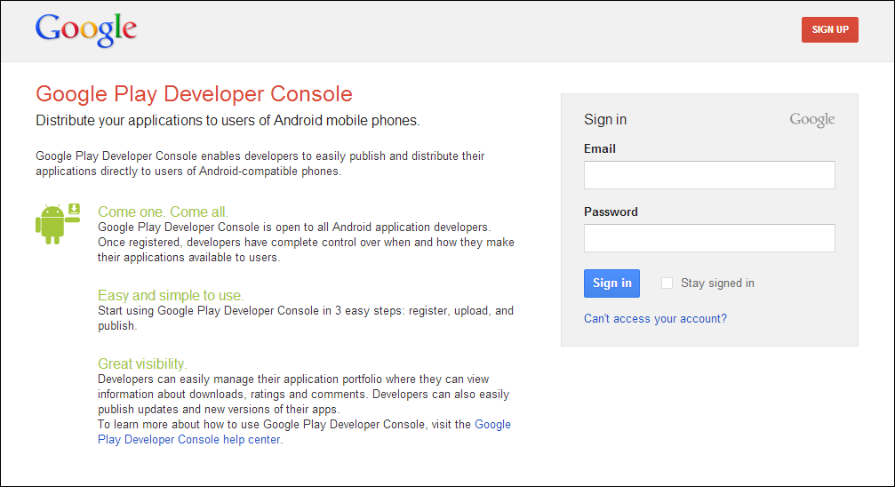
Signing Up for Publishing to Google Play
Notes:
The Google Play Developer Console website.

Slide 32
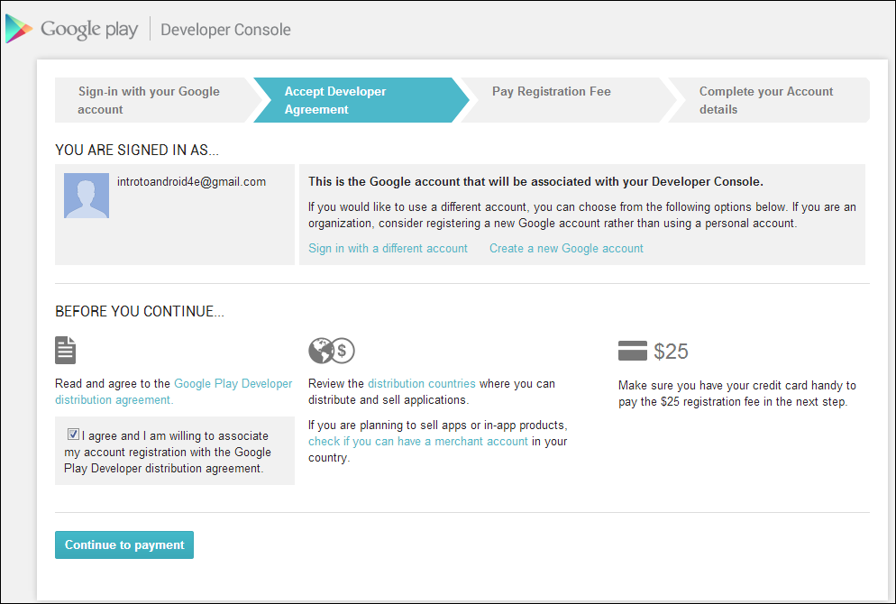
Signing Up for Publishing to Google Play (Cont’d)
Notes:
Creating a new developer account.

Slide 33
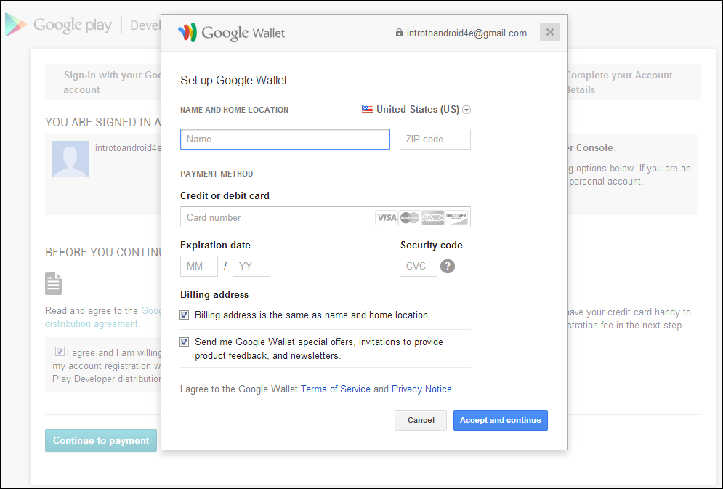
Signing Up for Publishing to Google Play (Cont’d)
Notes:
To publish applications through Google Play, you must register for a publisher account and set up a Google Wallet Merchant account.
Setting up a Google Wallet account.

Slide 34
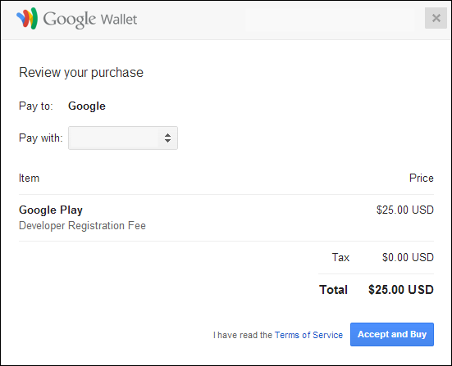
Signing Up for Publishing to Google Play (Cont’d)
Notes:
Paying the Google Play developer registration fee.

Slide 35
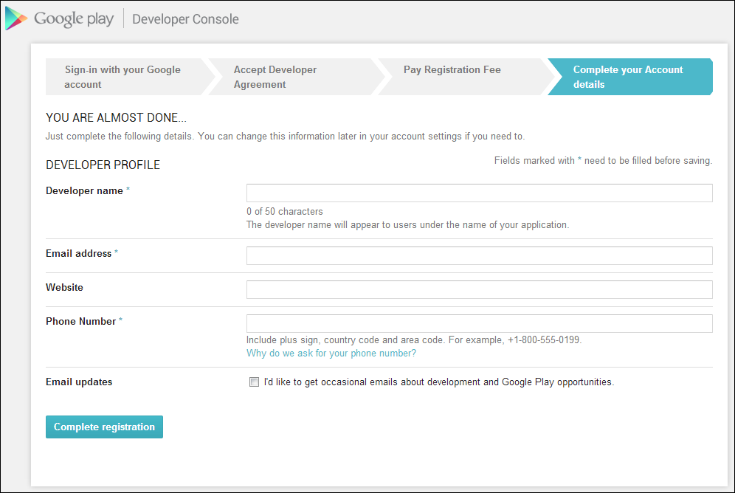
Signing Up for Publishing to Google Play (Cont’d)
Notes:
Completing the registration process.

Slide 36
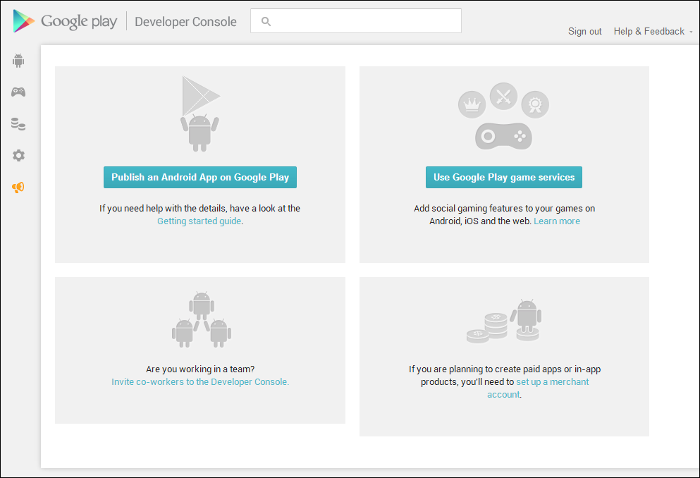
Signing Up for Publishing to Google Play (Cont’d)
Notes:
The home page of the Google Developer Console.

Slide 37
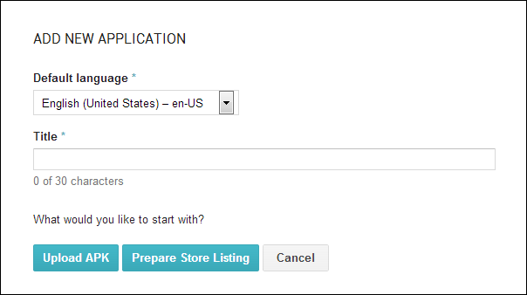
Uploading Your Application to Google Play
Notes:
Now that you have an account registered for publishing applications to Google Play and have a signed application package, you are ready to upload it for publication.
Here is a screenshot for adding a new application.

Slide 38
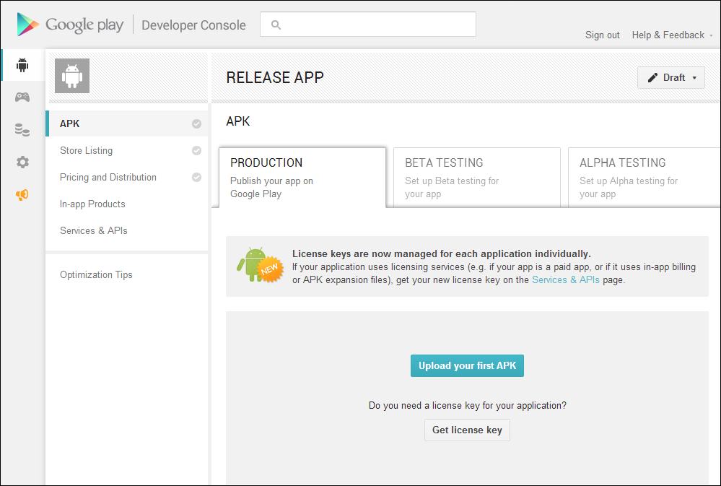
Uploading Your Application to Google Play (Cont’d)
Notes:
Upon selecting Upload APK from the previous screen, you see your new application listing; in this case the application is called RELEASE APP.

Slide 39
Uploading Application Marketing Assets
The Store Listing tab associated with your application begins with the Product Details section which allows you to perform the following tasks:
  Provide additional translations of your application
  Enter an application title, description, promo text, recent changes information
  Upload screenshots demonstrating your application on different-size devices, in particular a phone, a 7-inch tablet, and a 10-inch tablet
  Provide a high-resolution version of your application icon, a feature graphic, a promo graphic, and a promo video
  Enter categorization data for your application
  Provide contact details for your application
  Link to a privacy policy that your application provides

Slide 40
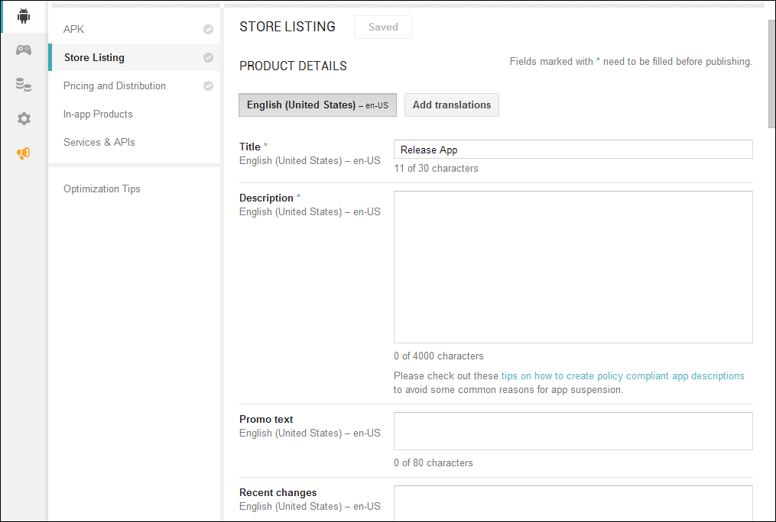
Uploading Application Marketing Assets (Cont’d)
Notes:
Viewing the Store Listing tab.

Slide 41
Configuring Pricing and Distribution Details
The Pricing and Distribution tab associated with your application allows you to enter pricing information
  Specify whether the application is free or paid
  Specify the countries where you would like to distribute your application
  Opt in to Google Play for Education
  Provide consent for acknowledging that your application abides by the Android content guidelines and export laws of your country

Slide 42
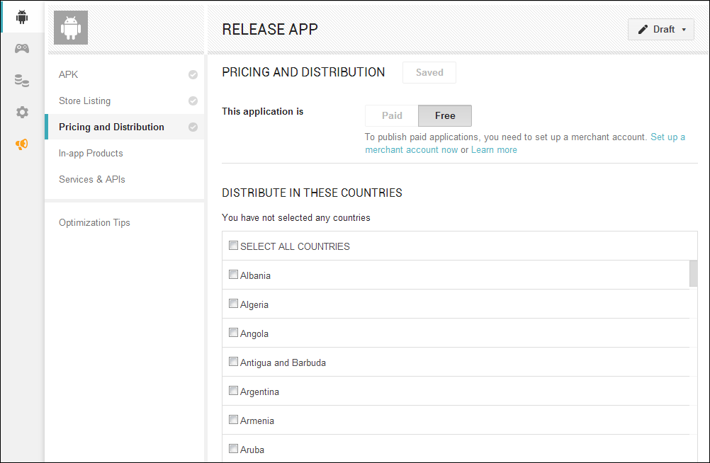
Configuring Pricing and Distribution Details (Cont’d)
Notes:
The Pricing and Distribution tab.

Slide 43
Configuring Additional Application Options
There are a few other tabs associated with your application that allow you to configure additional setup tasks:
  Specify in-app products for your application (requires adding the BILLING permission to your APK and setting up a Merchant account)
  Manage services and APIs such as Google Cloud Messaging (GCM), Licensing and In-app Billing, and Google Play Game Services
  Implement additional optimization tips for improving your app listing on Google Play

Slide 44
Managing Other Developer Console Options
In addition to managing your applications, you can also set up Google Play Game Services and review detailed financial reports for your paid applications
To review financial reports, you must have a Merchant account set up to enable paid apps
Financial information is downloadable in CSV format

Slide 45
Google Play Game Services
A new addition to Google Play is the Google Play Game Services APIs
These APIs allow you to add leaderboards, achievements, real-time multiplayer services, and save game data using the Cloud Save APIs
From the Developer Console, you must accept the Google APIs terms of service before you can begin integrating game services into your application

Slide 46
Publishing Your Application to Google Play
Once you have entered all the required information, you should be ready to transition your application from a draft to publishing on Google Play
Once you publish, your application appears in Google Play almost immediately
After publication, you can see statistics including ratings, active installs, and crashes in the All Applications section of the Developer Console

Slide 47
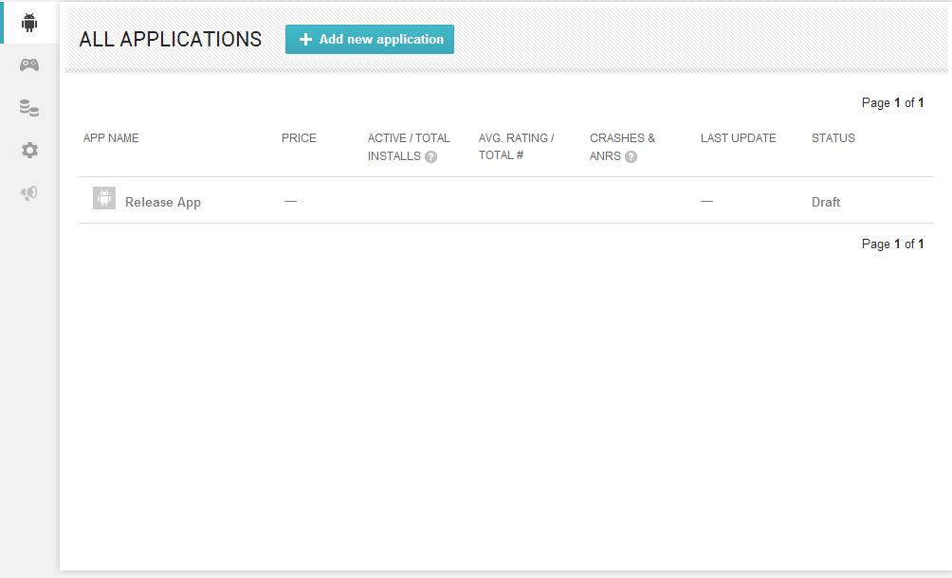
Publishing Your Application to Google Play (Cont’d)
Notes:
Viewing the All Applications section of the Developer Console.

Slide 48
Managing Your Application on Google Play
Once you’ve published your application to Google Play, you will need to manage it
Some considerations include understanding how the Google Play return policy works, managing application upgrades, and, if necessary, removing your application from publication

Slide 49
Understanding the Google Play Application Return Policy
Google Play currently has a 15-minute refund policy on applications: a user can use an application for 15 minutes and then return it for a full refund
However, this applies only to the first download and first return; if a particular user has already returned your application and wants to “try it again,” he or she must make a final purchase—and can’t return it a second time
Although this limits abuse, you should still be aware that if your application has limited reuse appeal, you might find that you have a return rate that’s too high and need to pursue other methods of monetization

Slide 50
Upgrading Your Application on Google Play
You can upgrade existing applications from the Android Developer Console
Simply upload a new version of the same application using the Android manifest file tag android:versionCode
When you publish it, users receive an Update Available notification, prompting them to download the upgrade

Slide 51
Removing Your Application from Google Play
You can also use the Unpublish action in the Android Developer Console to remove the application from Google Play
The Unpublish action is immediate, but your application entry in the Google Play application might be cached on handsets that have viewed or downloaded the application
Keep in mind that unpublishing the application makes it unavailable to new users but does not remove it from existing users’ devices

Slide 52
Google Play Staged Rollouts
In the case that you are not yet ready to offer your application for download to the entire world, you are able to distribute your application as a prerelease version
This allows you to define alpha and beta test groups, so you are able to generate feedback prior to offering your application to all of Google Play
Any reviews provided will not be visible in the Google Play store, which provides you an opportunity to fix any defects that may generate negative reviews before they affect the perception of your application

Slide 53
Publishing to the Google Play Private Channel
If you have a Google Apps domain, Google allows you to launch and distribute your application in a private way, to the users of your Google Apps domain
The distribution occurs through the Google Play store and can be useful if your application should be restricted to only those within your organization
Rather than having to set up your own distribution mechanisms for internal distribution, you are able to leverage all of the powerful features that Google Play provides, without needing to make your application available to users outside of the group that should have access

Slide 54
Translating Your Application
Since Google Play is available to users in 130 different countries, and growing, translating your application into different languages should be thought about early on in the development process
There are simple measures that you can take for preparing your application for localization
  Design your application with localization in mind from Day 1
  Know which languages you may want to target first
  Do not hard-code strings into your application; use string resources, then all you need to do is have the string resources translated
  The Google Play Developer Console is now offering a pilot program to enable developers to hire professional translators to translate string resources they provide
  Make sure that once your application has been translated you also test the application in each language
    Some translations may require more textual content, therefore pushing your user interface out of whack
    Testing for this scenario is important because users won’t want to use an application that does not display properly

Slide 55
Publishing Using Other Alternatives
Many alternative distribution mechanisms other than Google Play are available to developers
Application requirements, royalty rates, and licensing agreements vary by store
Third-party application stores are free to enforce whatever rules they want on the applications they accept, so read the fine print carefully
They might enforce content guidelines, require additional technical support, and enforce digital signing requirements
Only you and your team can determine which are suitable for your specific needs

Slide 56
Publishing Using Other Alternatives (Cont’d)
Here are a few alternative marketplaces where you might consider distributing your Android applications:
  Amazon Appstore is an example of an Android-specific distribution website for free and paid applications (http://amazon.com/appstore)
  Samsung Apps is an app store managed by one of the most successful Android device manufacturers on the market (http://apps.samsung.com)
  GetJar boasts about having over 100 million users, so this is definitely an Android market to consider adding your application to (http://www.getjar.com/)
  Soc.io Mall (formerly AndAppStore) is an Android-specific distribution site for free applications, e-books, and music using an on-device store (http://mall.soc.io)
  Handango distributes mobile applications across a wide range of devices with various billing models (http://www.handango.com)
  AT&T Apps is an example of a store run by the carrier AT&T for its mobile subscribers (http://www.att.com/shop/apps.html)

Slide 57
Self-Publishing Your Application
You can distribute Android applications directly from a website, server, or email
The self-publishing method is most appropriate for vertical market applications, content companies developing mobile marketplaces, and big-brand websites wanting to drive users to their branded Android applications
It can also be a good way to get beta feedback from end users
Although self-distribution is perhaps the easiest method of application distribution, it might also be the hardest in which to market, protect, and make money
The only requirement for self-distribution is to have a place to host the application package file

Slide 58
Self-Publishing Your Application (Cont’d)
There are downsides to self-distribution
  The Google Play licensing service will not be available to help you protect your application from piracy
  Google Play’s In-app Billing service is not available to apps outside of Google Play so you will have to manage the billing aspects yourself
  End users must configure their devices to allow packages from unknown sources
    This setting is found under the Security section of the device’s Settings application
    This option is not available on all consumer devices in the market

Slide 59
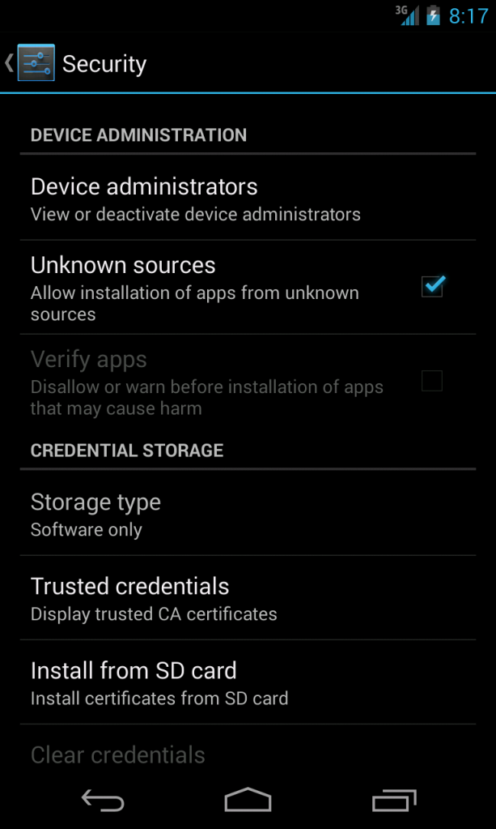
Self-Publishing Your Application (Cont’d)
Notes:
Enabling the Unknown sources option within the Android security settings.

